Slide 1
Angular

Slide 2
Contents

Slide 3
Services and Dependency Injection

Slide 4
Need of Services
Data source
Cross Component Communication

Slide 5
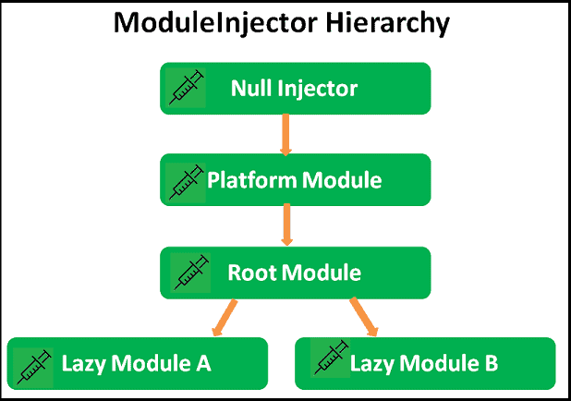
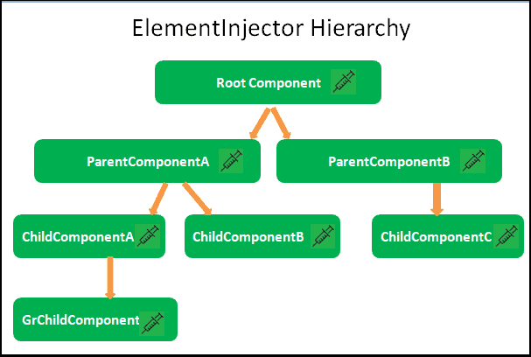
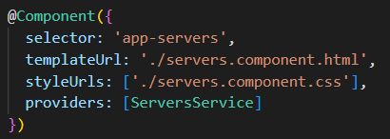

Hierarchical Dependency Injection

Slide 6
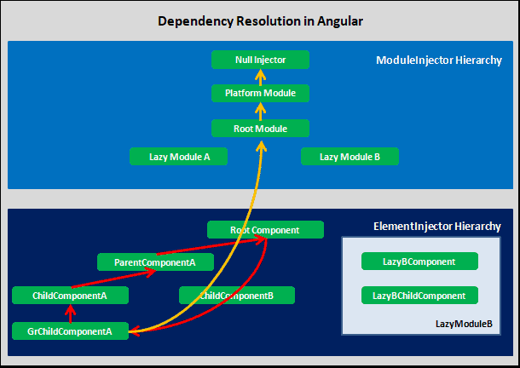
Dependency Resolution

Slide 7
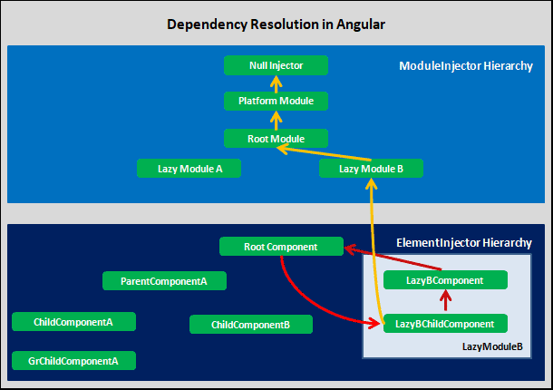
Dependency Resolution

Slide 8
Routing in Angular

Slide 9
RouterModule
Adds directives and providers for in-app navigation among views
Static methods
forRoot
forChild
Directives
RouterLink
RouterLinkActive
RouterOutlet

Slide 10
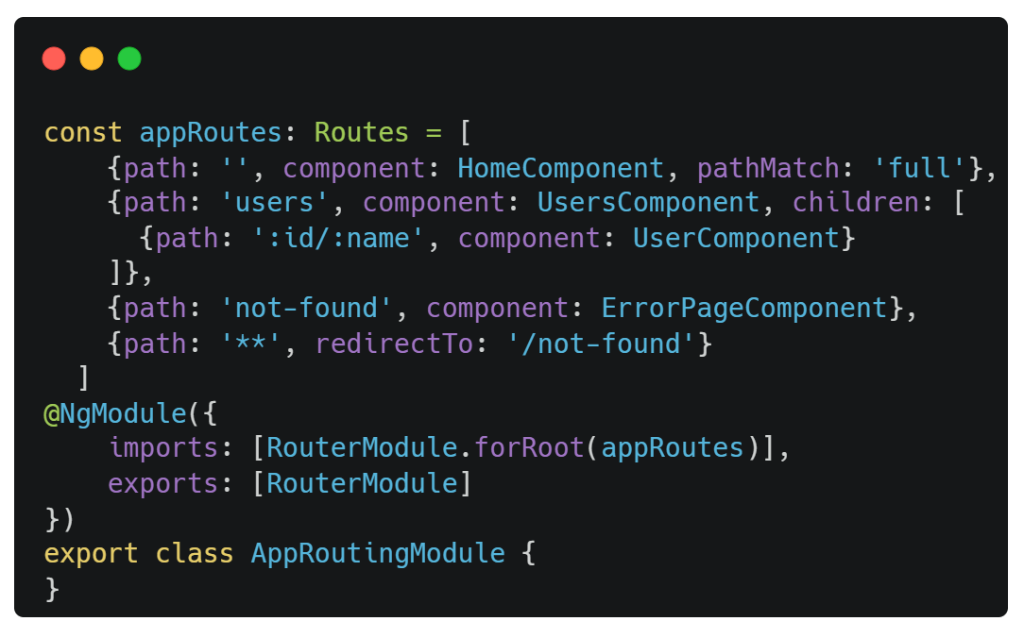
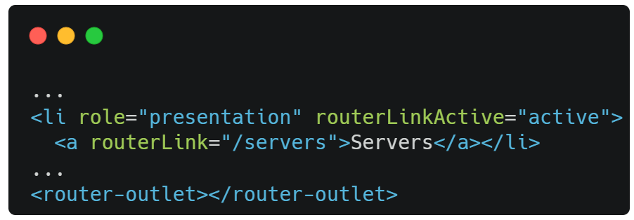
Setting up Routes

Slide 11
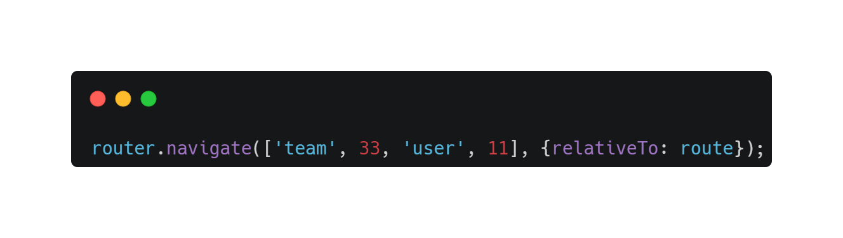
Navigating Programmatically
Router
A service that provides navigation among views and URL manipulation capabilities.

Slide 12
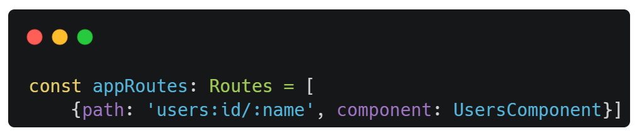
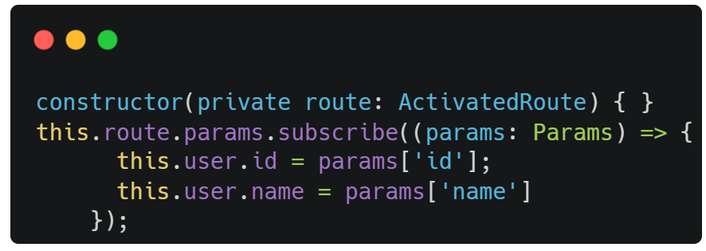
Passing and Fetching Parameters

Slide 13
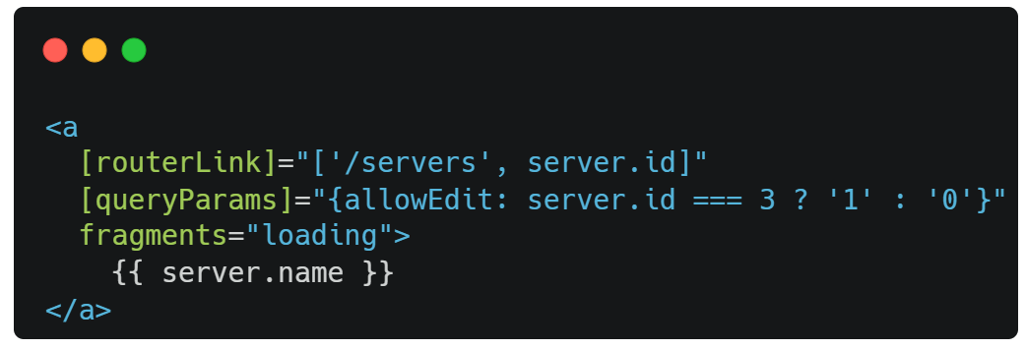
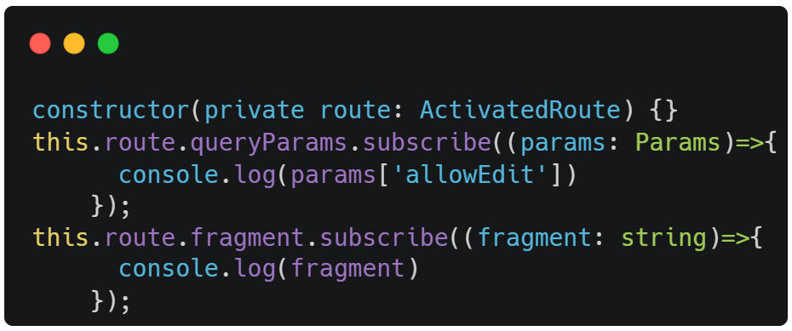
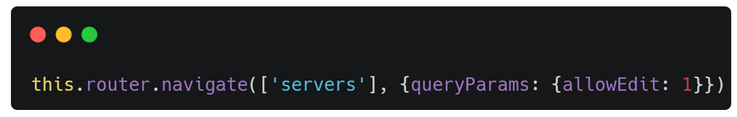
Query Parameters and Fragments

Slide 14
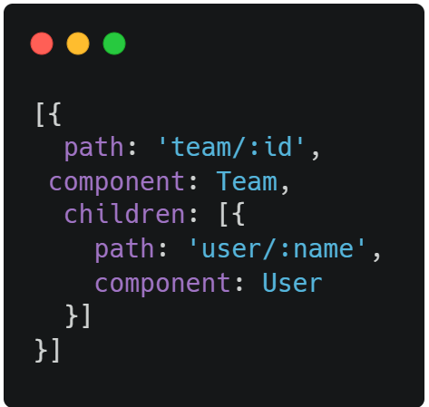
Child Routes
Navigation path 👇
/team/11/user/bob

Slide 15
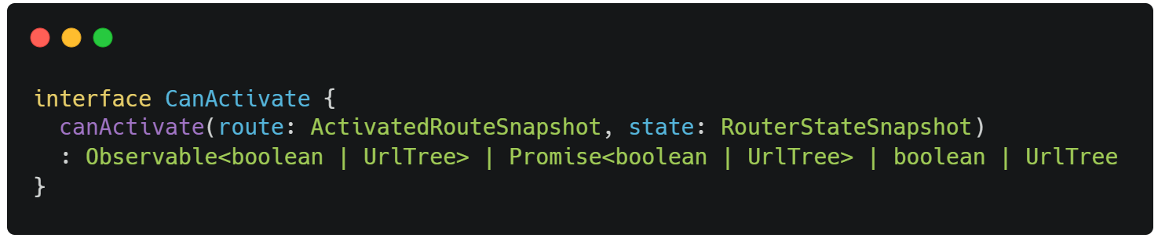
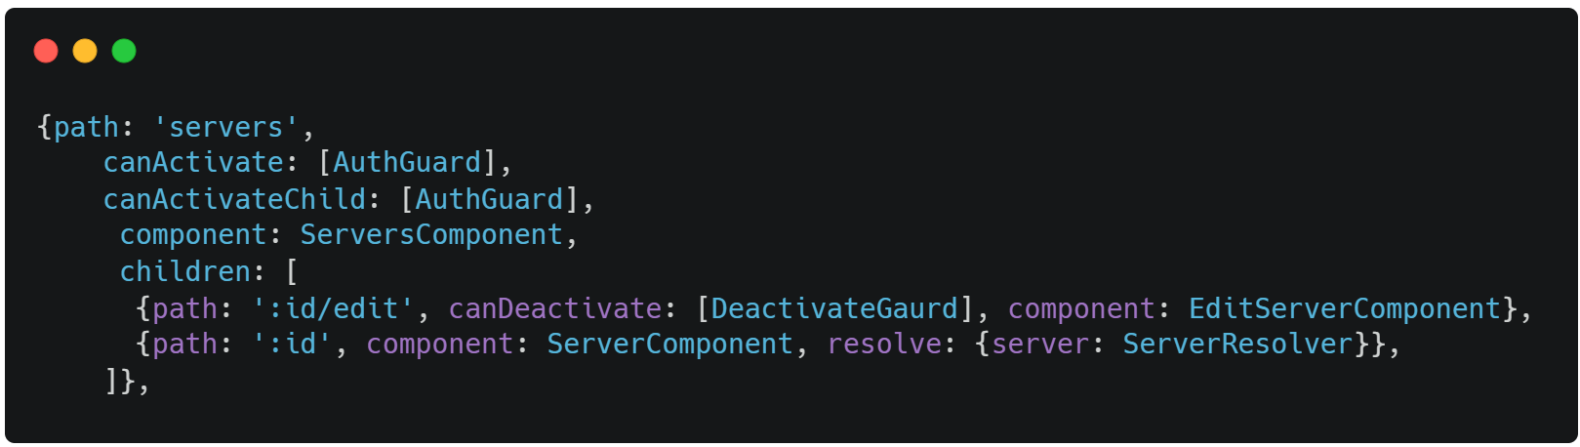
Guarding Routes
CanActivate
Guard deciding if a route can be activated.

Slide 16
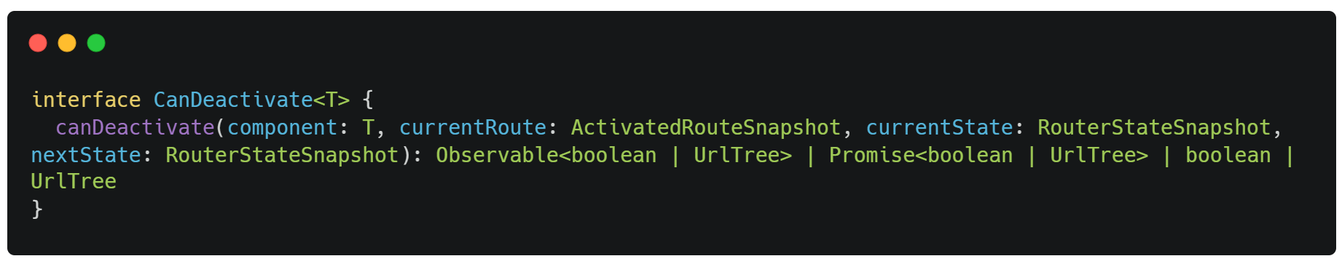
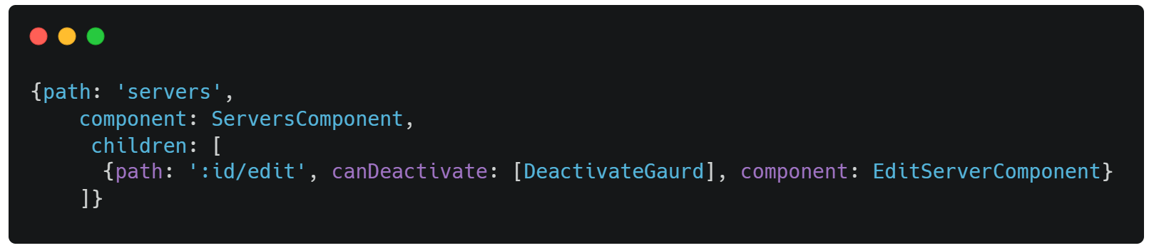
Guarding Routes
CanDeactivate
guard deciding if a route can be deactivated

Slide 17
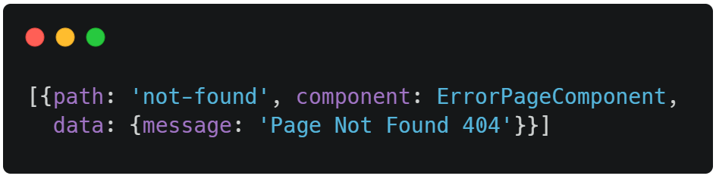
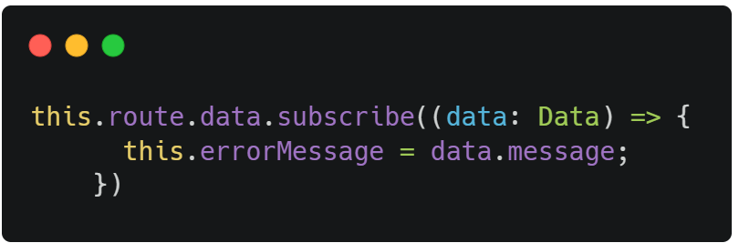
Passing Static Data

Slide 18
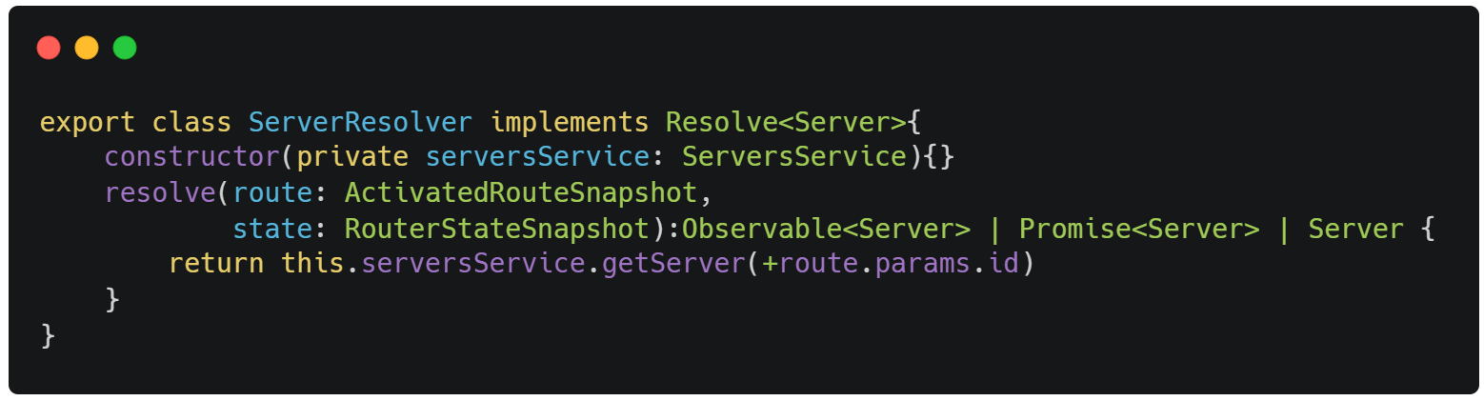
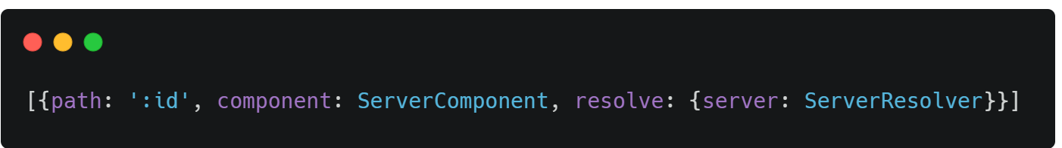
Data Resolvers
A data provider class can be used with the router to resolve data during navigation

Slide 19
Observable

